Slide 1
COG Summer Workshops 2022 Series
Data Visualization in R Presented By: Billy Mitchell
Notes:
Hey all, thanks for checking out this presentation on Data Visualization in R. We don’t have a ton of time, so I’m going to hop right into it

Slide 2

My Approach to This Workshop
I assume you are proficient with the R programming language and ggplot syntax (If not, see previous workshops)
My primary goal: Demonstrate how workshop attendees can make static visualizations dynamic, interactive, and aesthetically appealing.
Notes:
For the sake of time, we will assume users have a basic understanding of the R programming language. Those of you lacking such should still be able to run the script, but may have trouble with the exercises. For anyone hoping to get started with R, I highly recommend the R package Swirl, which is an instructional package which works right in R and gives you immediate feedback for any successes or errors you make
What I’m going to do in this workshop is share with you the script templates I use to visualize data at different stages and of different types such that you can hopefully adopt these templates and integrate them into your own analysis pipelines. I certainly don’t memorize these templates. I’m not going to have a lot of exercises that demand you do much coding, because that’s not how I personally visualize my data anyway. I feel writing out all of that code when a lot of it is going to be standardized from plot to plot to be a waste of time. I will have some comprehension checks where I ask you to try creating a plot we haven’t seen yet, but there’s not a lot of problem solving here. In my opinion, it’s moreso knowing that the resources exist in the first place and then knowing how to apply them. Instead, I’ll encourage all of you to play around with the settings and find what you personally find to be aesthetically pleasing.

Slide 3

Materials Needed
The following items are necessary to have:
R programming language
R Studio
.RDA dataframe (“df.rda”)
.HTML tutorial
Packages, namely:
Shiny
Plotly
gganimate
All of these materials or links to these items are accessible through the COG github!

Slide 4
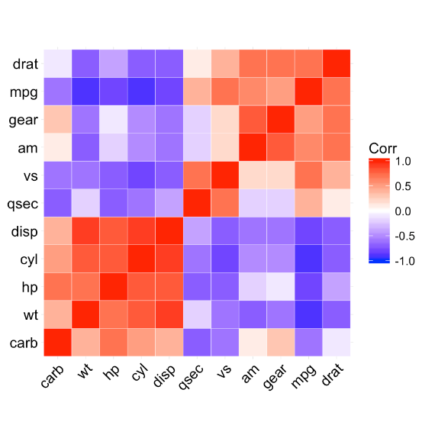
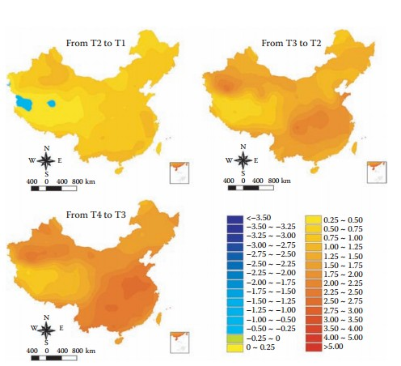
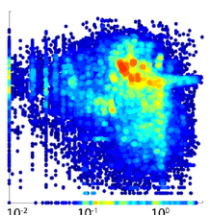
Why Visualize in R?
R offers users an integrated statistical analysis and visualization pipeline that is:
free
endlessly customizable
highly accessible
well documented

Slide 5
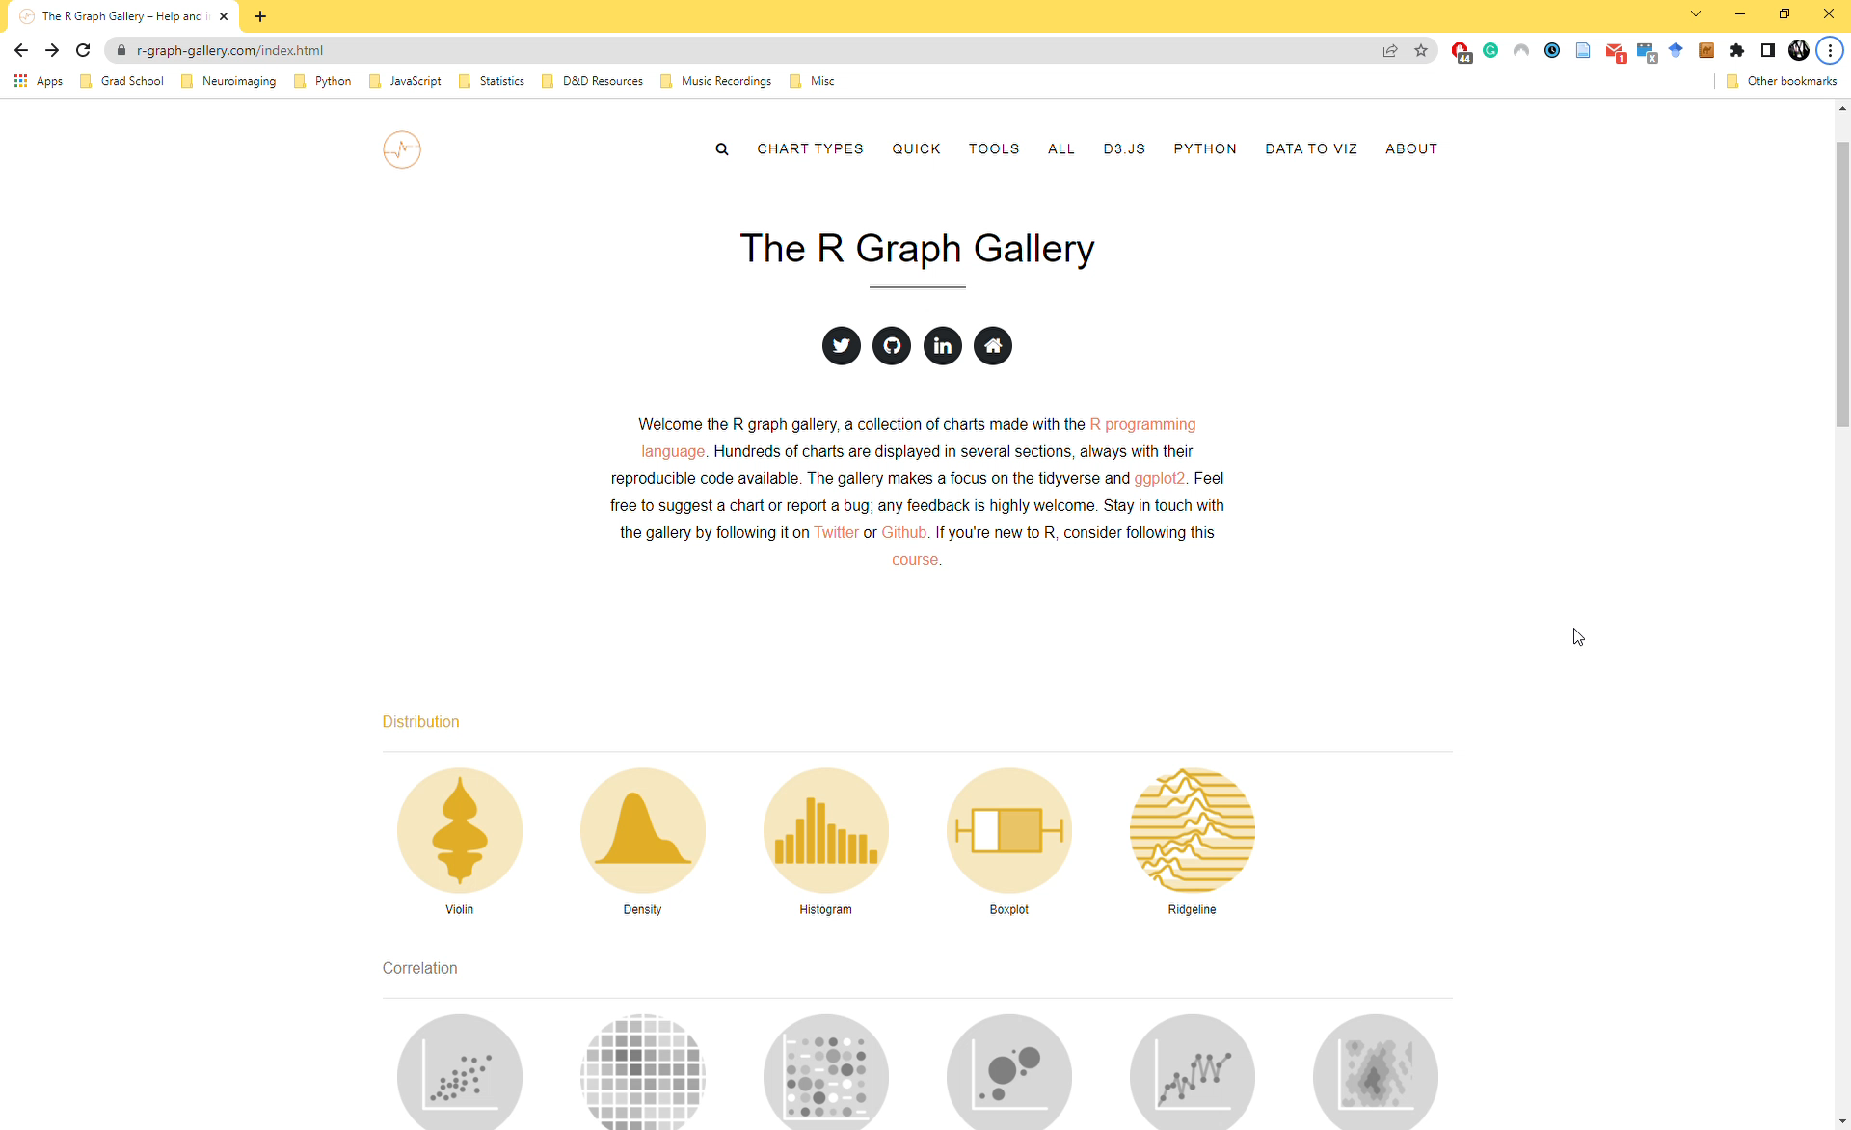

Slide 6

Workshop Roadmap
Introduction
Preparing Data
Conclusions
Data Distributions
Interactive Visualization
Animated Visualization
Reactive Visualization

Slide 7
COG Summer Workshops 2021 Series
Data Visualization in R

Slide 8

Practical Suggestions to Maintain Your Sanity
Maintain a template with placeholder variables that can easily be replaced using the find and replace function in R.
Google is your best friend
Maintain a bookmarks folder with all of my favorite blogs/worksheets
Use other people’s code
Have patience

Slide 9

R Alternatives
Python
Adobe Illustrator

Slide 10
Thanks for joining!
Contact: billy.mitchell@temple.edu

